Slide 1
Social Psychology
Fall 2016
PSY 101
Prof: Dr. Doe Buchli, PhD

Slide 2
What is Social Psychology?
The scientific study of how we think about, influence, and relate to one another
Some topics social psychologist study:
How do we form impressions about others
What causes attitude change?
Why do people conform? Obey orders?
Does being a member of a group change your behavior?
What causes interpersonal attraction?

Slide 3
Perceiving Others
Social Perception: the process by which we come to understand other people
How do we come to judge other people and form impressions?
Behaviors
Appearance
Situation

Slide 4
Scenario
Amy does poorly on an exam. She blames it on the fact that the questions were hard and she didn’t get very much sleep the night before. When her younger brother also comes home with a poor exam grade, she launches into a lecture about he has to learn how to apply himself and stop being so lazy.
When someone cuts you off driving down the freeway, you curse silently in your head (or out loud) about how rude of a driver that person is. Fast forward a few days later: You’re thinking about the psych exam you’re going to have to take soon and accidentally cut someone off…whoops.
What’s happening here?
Notes:
Judge people by their behaviour, but judging our own behaviour by our external environment

Slide 5
Attribution Theory
The way that people explain the causes of their own behavior and other people’s behavior
Dispositional (Personal/Internal) Attribution: Attributions to enduring, stable traits (e.g., internal characteristics of a person, such as ability, personality, or effort)
Situational Attribution (Circumstance/External): Attributions specific to the situation or circumstance the individual is in (external factors, such as the task, other people, or luck)

Slide 6
Fundamental Attribution Error (FAE)
The tendency to overestimate the extent to which other people’s behavior is due to personal factors and to underestimate the role of situational factors
A student comes in late to class
Dispositional attribution
Student doesn’t care about class
Situational attribution
Train was late

Slide 7
Jones & Harris (1967)
Participants read an essay either supporting or opposing Castro
Were told that the author was either given a choice or told which side to support
Participants then asked to rate author’s feelings about Castro
Participants assumed that the essay reflected the authors true feelings, even when they knew he had no choice in essays

Slide 8
Culture & the FAE
FAE is especially prevalent in Western, individualistic societies
In collectivist cultures, people tend to…
Attribute others’ behavior to the situation
Give others credit for their successes
Take more blame for failure on themselves
Why?
Notes:
Being in collective culture than being individualist culture reduces fae
Also knowing the person, or putting yourself in their shoes reduces fae

Slide 9
What are the consequences of our attributions?
Decide whether friendliness reflects happy disposition or romantic/sexual interest?
Does a loved one’s rude remark reflect a bad day or a mean spirit?
A jury must decide whether a shooter acted out of malicious mal-intent/ evil or in self-defense
Our homeless people on the streets because they are lazy or because of economic/social circumstances?

Slide 10
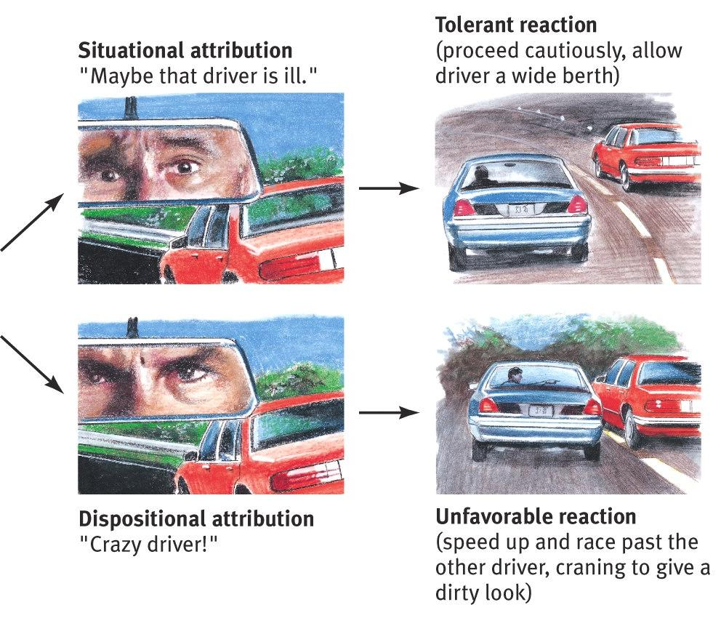
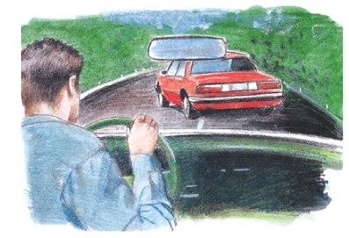
Consequences of Attribution
Problematic behavior: someone cuts in front of us.
How we explain someone’s behavior affects how we react to it.
Notes:
This effect is somewhat tangential to the social psych concept, but connects to the topic of attitude coming up.

Slide 11
Self-serving Bias
Our errors are due to the situation, but our successes are due to our personal traits
Fail: “That was a hard test”
Pass: “I’m a genius”
Same effect if you put yourself in someone else’s position (you become the actor)

Slide 12
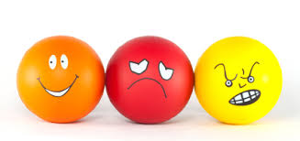
Attitude and Behavior
Attitudes—feelings, often influenced by our beliefs, that predispose us to respond in a particular way to objects, people, and events

Slide 13
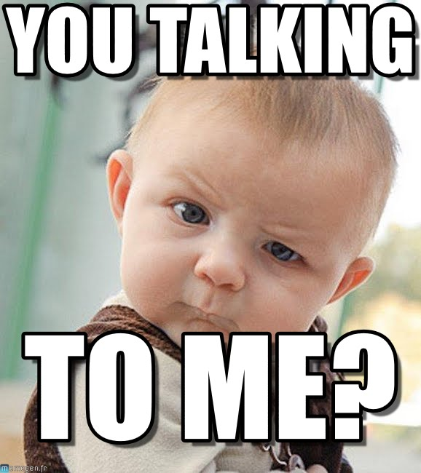
Attitudes affect actions
Attitudes affect actions
If we believe someone is threatening us, we may feel fear and anger toward the person, and act defensively

Slide 14
Attitudes affect actions
Two cognitive pathways to affect attitudes
Peripheral Route Persuasion
Changing attitudes by going around the rational mind and appealing to fears, desires, associations.
emotions
Central Route Persuasion
Going directly through the rational mind, influencing attitudes with evidence and logic.
“My product has been proven more effective.”
“People who buy my product are happy, attractive!”
Notes:
Instructor: Students may see “Persuasion” as a social influence topic; but here, the influence on behavior is mediated by cognition (attitudes).
Petty and Cacioppo (1986a, 1986b) state that there are two “routes” to persuasion: central and peripheral. The central route to persuasion consists of thoughtful consideration of the arguments (ideas, content) of the message. When a receiver is doing central processing, he or she is being an active participant in the process of persuasion. Central processing has two prerequisites: It can only occur when the receiver has both the motivationand the ability to think about the message and its topic. If the listener doesn’t care about the topic of the persuasive message, he or she will almost certainly lack the motivation to do central processing. On the other hand, if the listener is distracted or has trouble understanding the message, he or she will lack the ability to do central processing. The peripheral route to persuasion occurs when the listener decides whether to agree with the message based on other cues besides the strength of the arguments or ideas in the message. For example, a listener may decide to agree with a message because the source appears to be an expert, or is attractive. The peripheral route also occurs when a listener is persuaded because he or she notices that a message has many arguments -- but lacks the ability or motivation to think about them individually. In other words, peripheral cues, like source expertise (credibility) or many arguments in one message, are a short-cut. I don’t want to or can’t think carefully about the ideas in this persuasive message, but it is a fair gamble to go ahead agree with the message if the source appears to be knowledgeable or if there are many arguments in support of the message. This route occurs when the auditor is unable or unwilling to engage in much thought on the message. Receivers engaged in peripheral processing are more passive than those doing central processing.

Slide 15
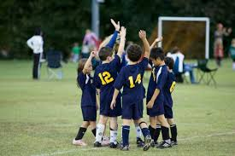
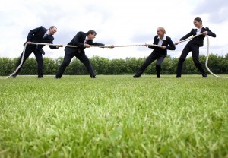
Actions affect attitudes
Cooperative actions, such as those performed by people on sports teams, feed mutual liking.
Such attitudes, in turn, lead to positive behavior

Slide 16
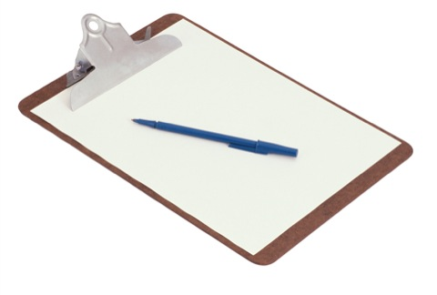
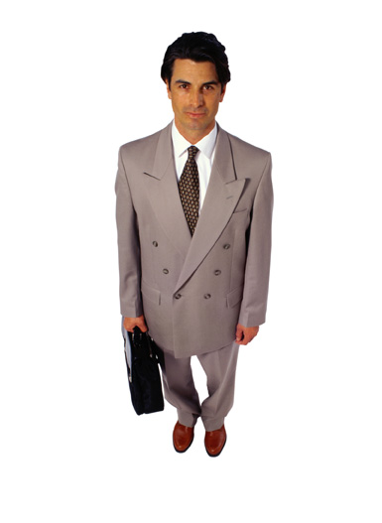
Actions affect attitudes
A political campaigner asks if you would open the door just enough to pass a clipboard through. [Or a foot]
You agree to this.
Then you agree to sign a petition.
Then you agree to make a small contribution. By check.
What happened here?

Slide 17
Actions affect attitudes
The Foot-in-the-Door Phenomenon: the tendency to be more likely to agree to a large request after agreeing to a small one.
Affect on attitudes: People adjust their attitudes along with their actions, liking the people they agreed to help, disliking the people they agreed to harm.
Notes:
The atrocities at Abu Ghraib, used as an example of role playing in the book, may also be an example of the foot in the door phenomenon, if: as prisoners were harmed, attitudes about the prisoners became more dehumanizing, allowing harm to escalate.

Slide 18
Cognitive Dissonance
We experience dissonance when our actions are not in line with our attitudes
To bring them in line with each other, we can either change our actions or change our attitudes
In cases where you don’t change your action or have no good justification for doing things you do not agree with….you change your attitude
Festinger’s Study (1957): Students were paid either large or small amounts to express enjoyment of a boring activity. Then many of the students changed their attitudes about the activity. Which amount shifted attitudes?
Getting paid more: “I was paid to say that.”
Getting paid less: “Why would I say it was fun? Just for a dollar? Weird. Maybe it wasn’t so bad, now that I think of it.
Notes:
Festinger’s Study (1957): Students were paid either large or small amounts to express enjoyment of a boring activity. Then many of the students changed their attitudes about the activity. Which amount shifted attitudes?
Getting paid more: “I was paid to say that.”
Getting paid less: “Why would I say it was fun? Just for a dollar? Weird. Maybe it wasn’t so bad, now that I think of

Slide 19

Actions affect attitudes: Role Playing
“No man, for any considerable period, can wear one face to himself, and another to the multitude, without finally getting bewildered as to which may be the true [face].”
-- Nathaniel Hawthorne
“Fake it till you make it.”
--Alcoholics Anonymous slogan
When we play a role, even if we know it is just pretending, we eventually tend to adopt the attitudes that go with the role, and become the role.
Notes:
A tragic story which may relate to the second bullet is the possible suicide of Heath Ledger who complained before his death that he was becoming disturbed by the attitudes he adopted while immersing himself in the role of the Joker in a Batman movie.
Instructor: if you play excerpts from the Stanford prison study video, I strongly recommend featuring the interviews at the end which show how the attitudes remained after the role playing was done.

Slide 20
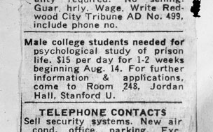
Stanford Prison Experiment
74 volunteers responded.
All were given a battery of psychological tests and the most normal 24 men were selected.
These 24 were randomly divided into two groups: Guards and Prisoners
Began with 9 guards and 9 prisoners; the rest were put “on call”
Scheduled to run for 2 weeks
Notes:
These are the clips shown in class, but the whole video is interesting if you have the time:
2:40-10:30—beginning of study
37:40-39:30ish - guard talks afterwards

Slide 21
What did we learn from the Stanford Prison Experiment?
Power of social roles (guards vs. prisoners)
Set of expectations about a social position
Defines how we think we should behave in social situations
Ethical guidelines
Implications for today
Abu Ghraib
Notes:
When we play a role, even if we know it is just pretending, we eventually tend to adopt the attitudes that go with the role, and become the role.

Slide 22
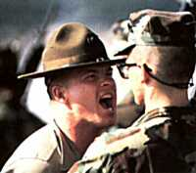
Social Influence
Obedience: following direct commands, usually from an authority figure
Conformity: changing behavior because of real or imagined group pressure

Slide 23
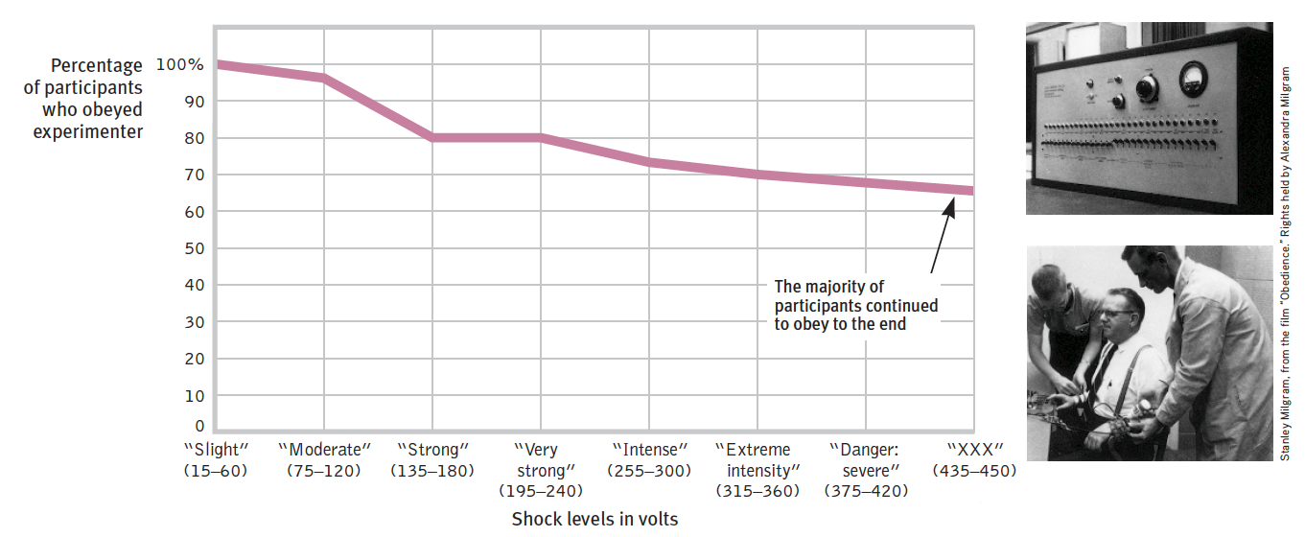
MILGRAM’S FOLLOW-UP OBEDIENCE EXPERIMENT
In a repeat of the earlier experiment, 65 percent of the adult male “teachers” fully obeyed the experimenter’s commands to continue. They did so despite the “learner’s” earlier mention of a heart condition and despite hearing cries of protest after they administered what they thought were 150 volts and agonized protests after 330 volts. (Data from Milgram, 1974.)
Notes:
Classic Milgram study: Volunteer told to teach another person (actually an accomplice in the experiment) word pairs by applying an electric shock each time the learner was wrong. The learner also told the volunteer that he had a heart condition.
65% obeyed by going all the way to 450 volts on the “shock machine” even though the learner eventually could not answer any more questions.
Milgrim Obedience, in earlier slides, 1.2?
https://www.youtube.com/watch?v=xOYLCy5PVgM

Slide 24
Factors that increase obedience
Obedience in the Milgram experiments was highest when
Person giving orders was nearby and was perceived as a legitimate authority figure
Research was supported by a prestigious institution
Victim was depersonalized or at a distance
There were no role models for defiance

Slide 25
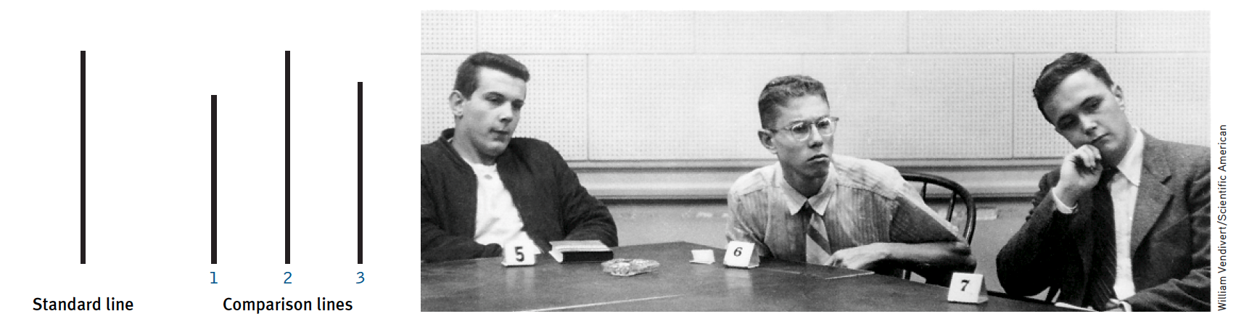
ASCH’S CONFORMITY EXPERIMENTS
Which of the three comparison lines on the left is equal to the standard line? The photo on the right (from one of the experiments) was taken after five people, who were actually working for Asch, had answered, “Line 3.” The student in the center shows the severe discomfort that comes from disagreeing with the responses of other group members.

Slide 26
Normative & informational social influence
Some participants said they didn’t want to look silly or be rejected by the rest of the group
This is referred to as normative social influence
They wanted to “fit in” with the others
Some participants said it was because they thought the others must have had better eyesight or be better informed in some way
This is referred to as informational social influence
They were basically utilizing others as a source of information
Notes:
Normative influence definition
Informational social influence definition

Slide 27
Factors that increase conformity
Solomon Asch and others have found that people are most likely to adjust their behavior or thinking to coincide with a group standard when
They feel incompetent or insecure
Their group has at least three people
Everyone else agrees
They admire the group’s status and attractiveness
They have not already committed to another response
They know they are being observed
Their culture encourages respect for social standards
Notes:
More susceptible to conformity effects
People 3+
Cultural affliction
If group is desirable

